Slide 1
Machine Learning 04- Linear Regression
Dr. Malak Abdullah
Computer Science Department
Jordan University of Science and Technology

Slide 2
What is Regression?
Regression is usually termed as determining relationship(s) between two or more variables.
Let’s say Y= 2*X + 3
X is termed as the independent variable and Y is termed as the dependent variable and Y has a continuous range (unlike classification where Y is discrete).
If we had multiple input attributes (e.g. x1, x2, x3, etc.) This would be called multiple linear regression.
Y= 2*X1 + 3*X2 + 0.5*X3 + 2

Slide 3
Types of Regression Models
1 Explanatory Variable
Regression
2+ Explanatory Variables
Models
Simple
Multiple
Non-
Non-
Linear
Linear
Linear
Linear
Notes:
24
This teleology is based on the number of explanatory variables & nature of relationship between X & Y.

Slide 4
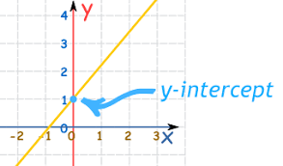
Simple Linear Regression
Simple Linear Regression (SLR) is termed as simple because there is only an independent variable.
For example, if you only have a company's date and stock prices, you can fit a regression model to the date (as X) and stock price (as Y).
The model look something like this: Price = m*Date + c
The equation resembles that of a line with ‘m’ slope and ‘c’ y-intercept.
The equation of any straight line, called a linear equation, can be written as: y = mx + c, where m is the slope of the line and c is the y-intercept. The y-intercept of this line is the value of y at the point where the line crosses the y axis.

Slide 5
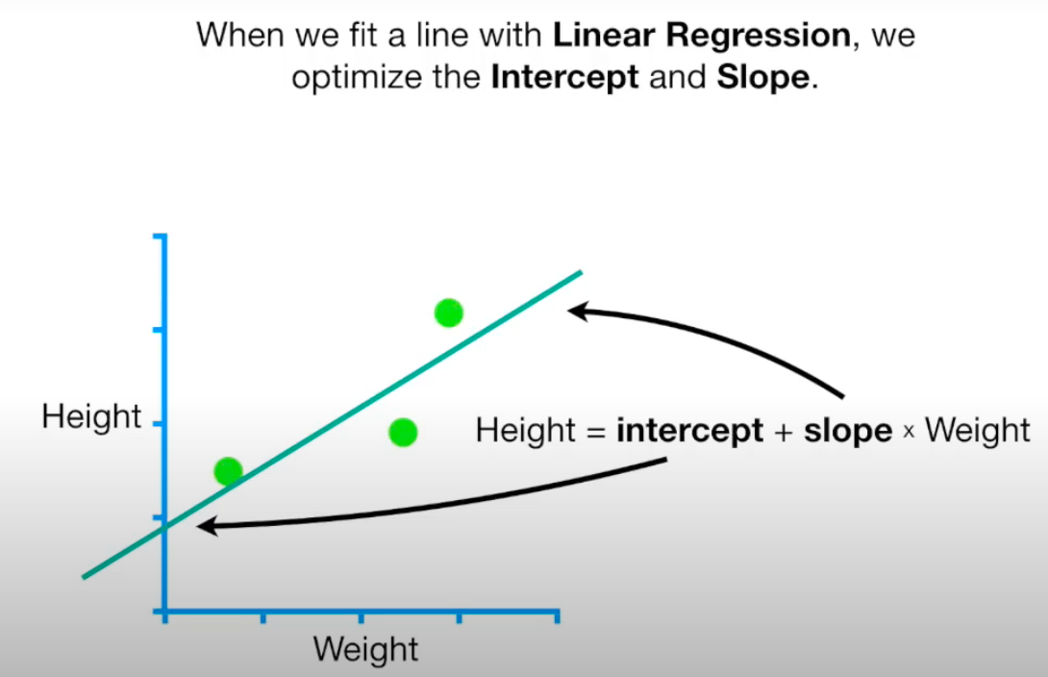
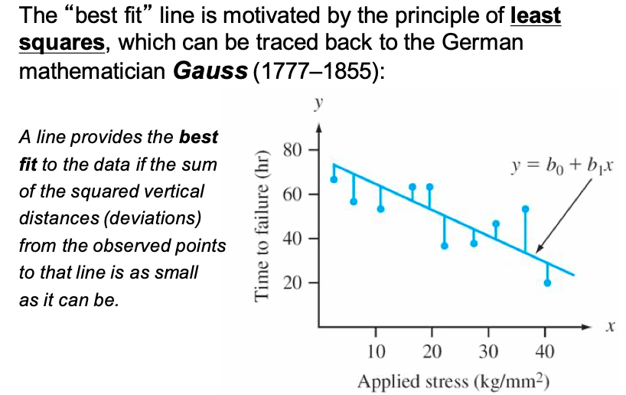
The most suitable values of ‘m’ and ‘c’ are the ones that produce the least error across all given X and Y.
Take the sum of the absolute difference of Y` and Y for all seen X. The values with the least sum are the most suitable values.
There are infinite values of ‘m’ and infinite values of ‘c’. Which one to choose!!

Slide 6
A quick shortcut for calculating the coefficients!
Least Squares Method
We want to model our data as follows:
y = B0 + B1 * x
This is a line where y is the output variable we want to predict, x is the input variable we know, and B0 and B1 are coefficients that we need to estimate to move the line around.
B0 (the intercept of the true regression line): The average value of Y when x is zero.
Technically, B0 is called the intercept because it determines where the line intercepts the y-axis. In machine learning, we can call this the bias because it is added to offset all predictions that we make. The B1 term is called the slope because it defines the slope of the line or how x translates into a y value before we add our bias.
Simple linear regression is the simplest form of regression and the most studied.
There is a shortcut that you can use to estimate the values for B0 and B1 quickly.

Slide 7
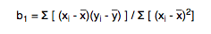

A quick shortcut for calculating the coefficients!
Least Squares Method
We can start off by estimating the value for B1 as:
B1 = sum((xi-mean(x)) * (yi-mean(y))) / sum((xi – mean(x))^2)
We can calculate B0 using B1 and some statistics from our dataset, as follows:
B0 = mean(y) – B1 * mean(x)

Slide 8
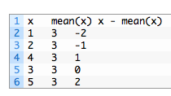
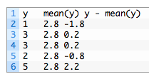
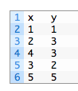
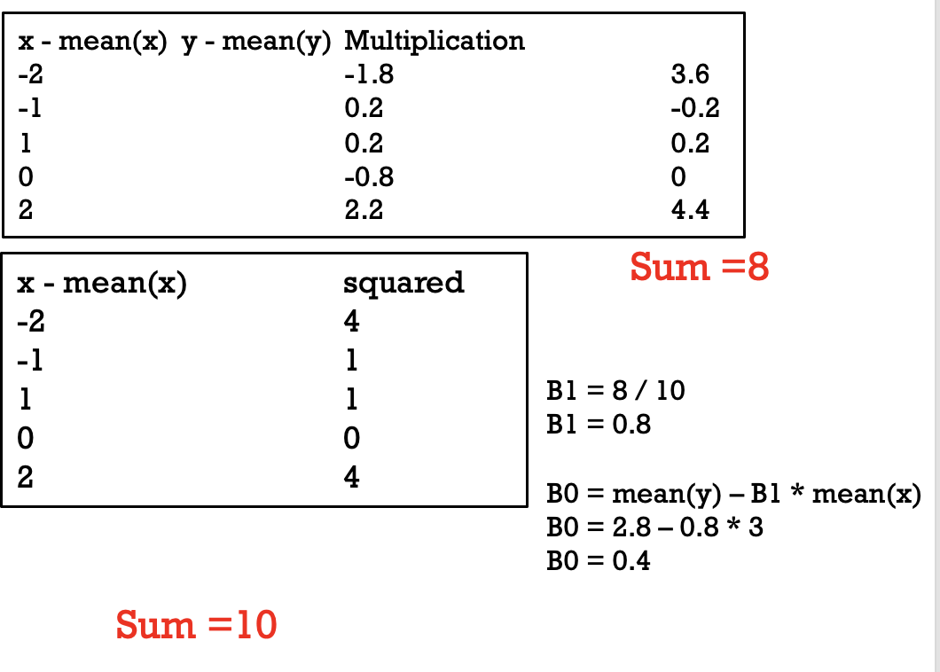
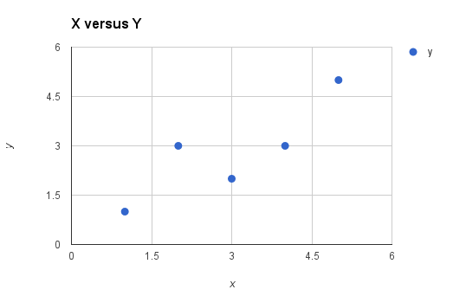
Example
mean(x) = 3
mean(y) = 2.8
Now we need to calculate the error of each variable from the mean.

Slide 9
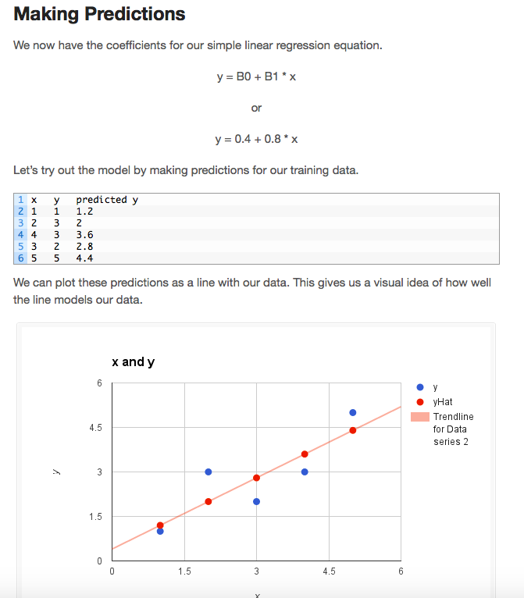
Prediction

Slide 10
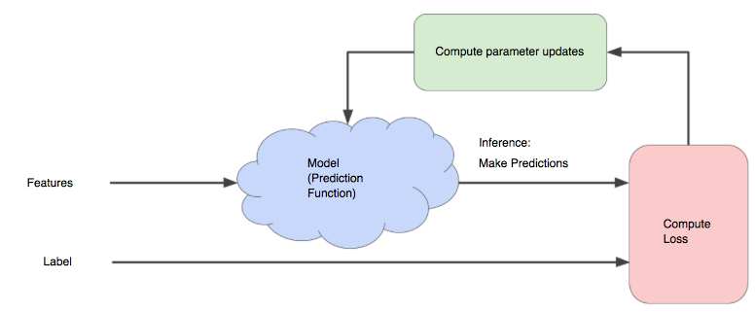
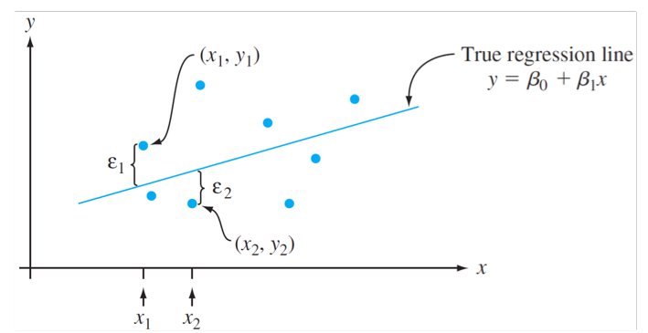
Just to check if you understand that
Once we find the best B₁ and B₀ values, we get the best-fit line. So, when we are finally using our model for prediction, it will predict the value of y for the input value of x.
How to update B₁ and B₀ values to get the best-fit line?

Slide 11
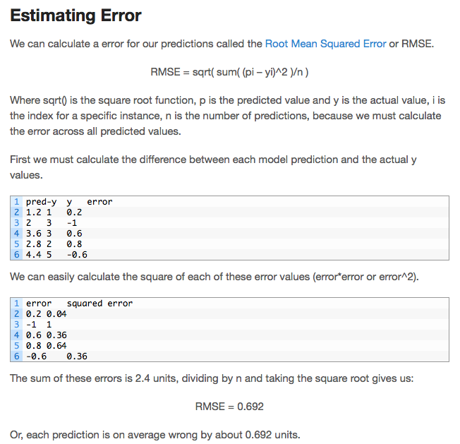
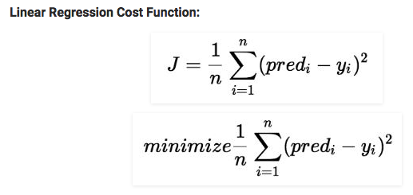
Cost Function (J):
Cost function(J) of Linear Regression can be the Root Mean Squared Error (RMSE) between predicted y value (pred) and true y value (y)
or

Slide 12
How to choose θ₀ and θ₁
To minimize the cost function, the model needs to have the best value of θ₀ and θ₁.
Initially, the model selects θ₀ and θ₁ values randomly and then iteratively updates these values in order to minimize the cost function until it reaches the minimum.
By the time the model achieves the minimum cost function, it will have the best θ₀ and θ₁ values.
Using these finally updated values of θ₀ and θ₁ in the hypothesis equation of linear equation, the model predicts the value of x in the best manner it can.
B₀ and B₁ ₌ θ₀ and θ_{1 = W0 and W1}

Slide 13
Multivariate regression
What if we have several inputs?
- Stock prices for Yahoo
- Microsoft and EBay for the Google prediction task
This becomes a multivariate regression problem
Again, it's easy to model:
y = B₀ + B₁x₁+ … + B_{k}x_{k} + ε
Multiple Linear Regression

Slide 14
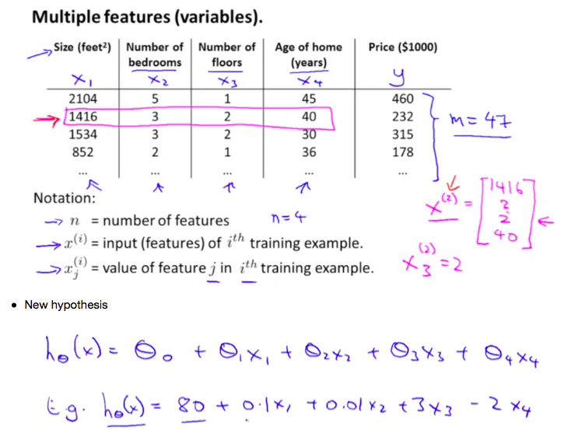

Slide 15
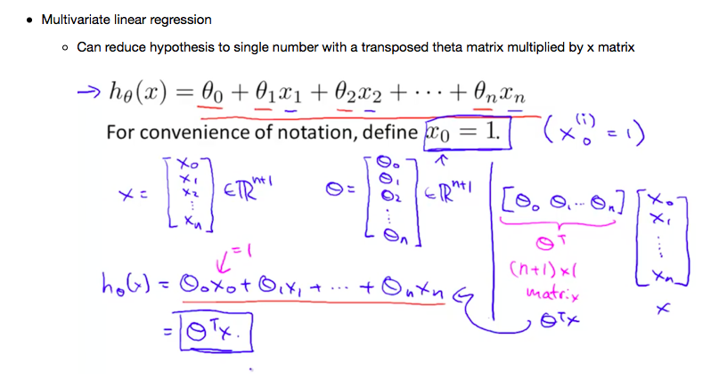

Slide 16
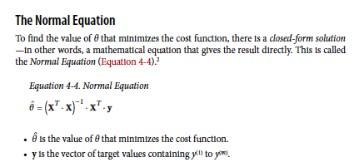
A shortcut to find the weights using Closed-Form solution

Slide 17
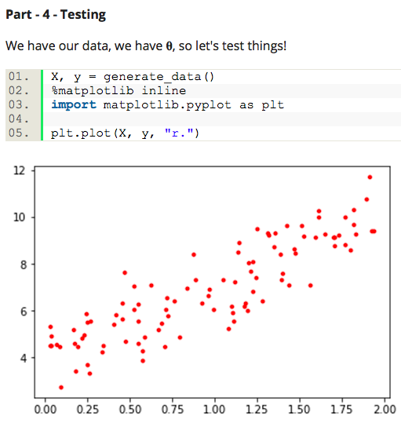
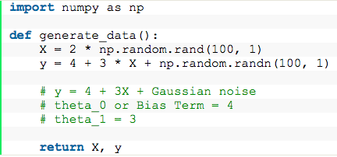
An Example
Data generation
X_b = np.c_[np.ones((100, 1)), X]
# set bias term to 1 for each sample
params = get_best_param(X_b, y)
print(params)
array([[ 3.94204397],
[ 3.08256508]])
from numpy.linalg import inv
def get_best_param(X, y):
X_transpose = X.T
best_params = inv(X_transpose.dot(X)).dot(X_transpose).dot(y)
# normal equation
# theta_best = (X.T * X)^(-1) * X.T * y
return best_params # returns a list

Slide 18
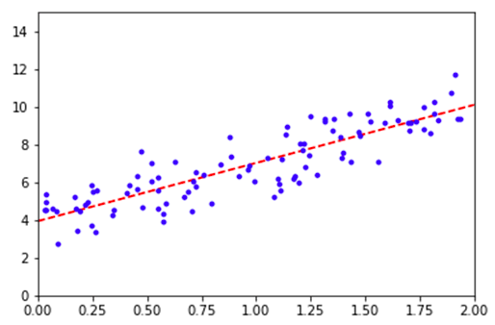
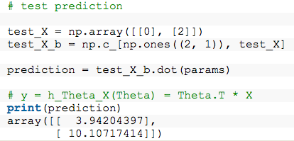
plt.plot(test_X, prediction, "r--")
plt.plot(X, y, "b.")
plt.axis([0, 2, 0, 15])
# x axis range 0 to 2, y axis range 0 to 15
plt.show()

Slide 19
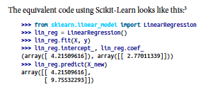
SKLearn

Slide 20
Another Solution to find weights: Gradient Descent
The goal is to minimize the cost function.
Minimizing any function means finding the deepest valley in that function.
This means getting to the lowest error value possible or increasing the accuracy of the model.
We increase accuracy by iterating over a training data set while tweaking our model's parameters (the weights and biases).
Do you remember the Calculus course?!?!
Using calculus, we know that the slope of a function is the derivative of the function with respect to a value. This slope always points to the nearest valley!
Gradient Descent is a very generic optimization algorithm capable of finding optimal solutions to a wide range of problems.

Slide 21
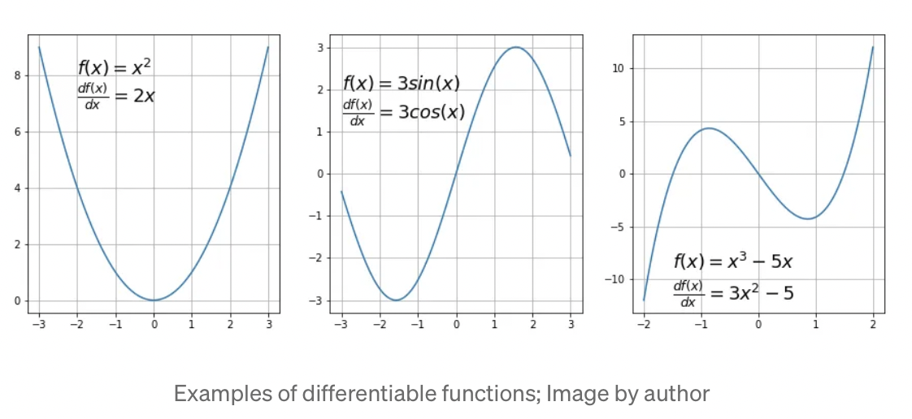
Important to know
Gradient descent algorithm does not work for all functions. There are two specific requirements. A function has to be:
differentiable
convex
First, what does it mean it has to be differentiable? If a function is differentiable it has a derivative for each point in its domain — not all functions meet these criteria. First, let’s see some examples of functions meeting this criterion:
Notes:
https://towardsdatascience.com/gradient-descent-algorithm-a-deep-dive-cf04e8115f21#:~:text=Gradient%20descent%20(GD)%20is%20an,e.g.%20in%20a%20linear%20regression).

Slide 22
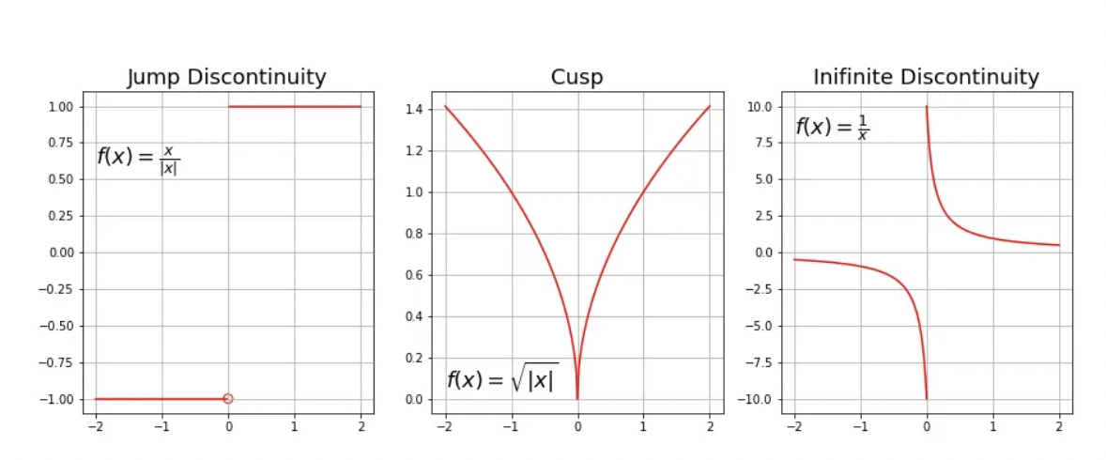
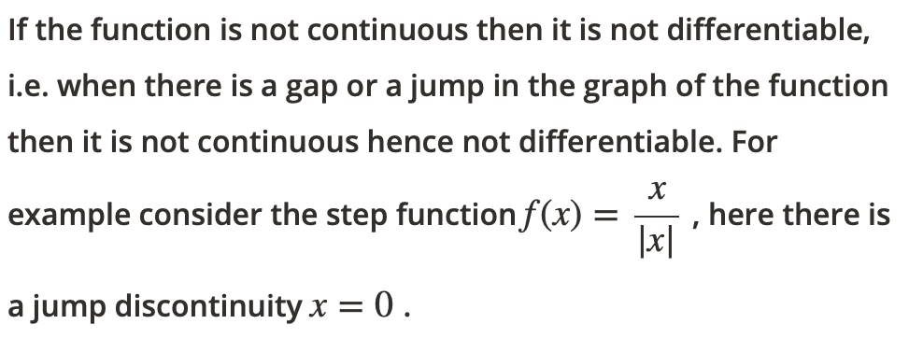
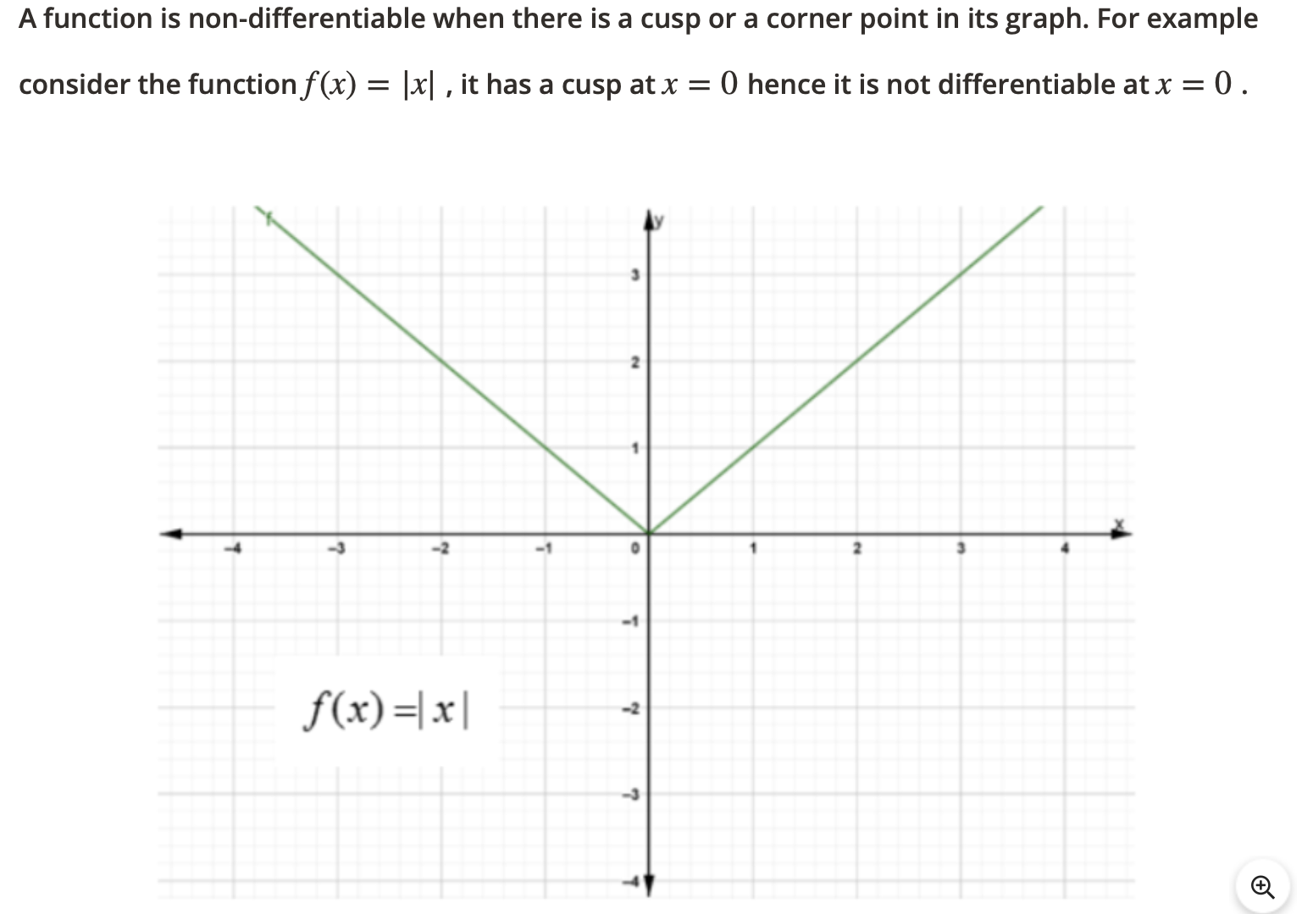
Non-Differentiable ☹

Slide 23
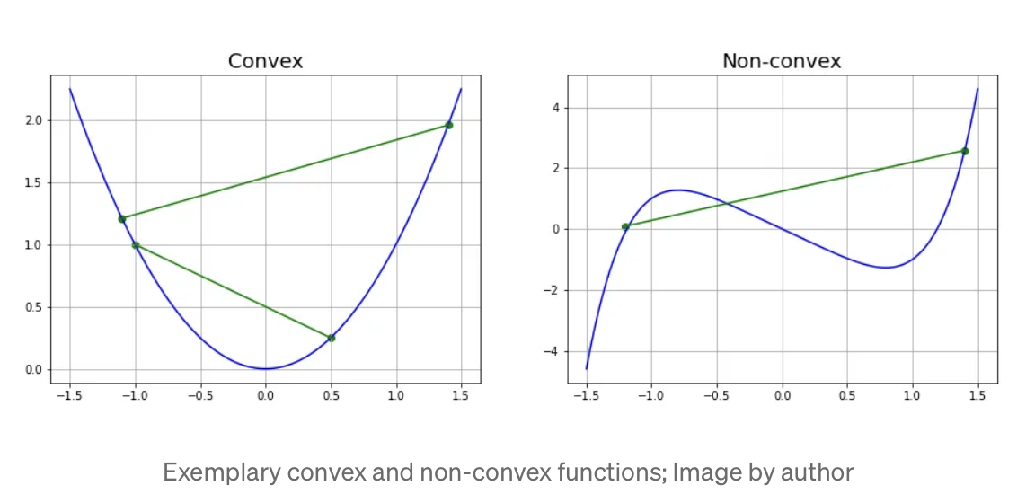
Convex Function
For a univariate function, this means that the line segment connecting two function’s points lays on or above its curve (it does not cross it). If it does it means that it has a local minimum which is not a global one.

Slide 24
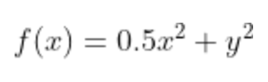
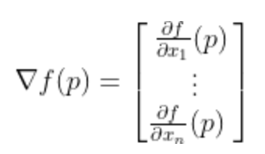
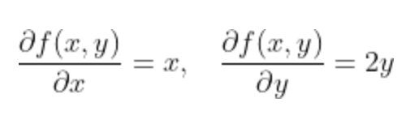
What is Gradient?
Intuitively it is a slope of a curve at a given point in a specified direction.
In the case of a univariate function, it is simply the first derivative at a selected point. In the case of a multivariate function, it is a vector of derivatives in each main direction (along variable axes). Because we are interested only in a slope along one axis and we don’t care about others, these derivatives are called partial derivatives.
A gradient for an n-dimensional function f(x) at a given point p is defined as follows:
Example

Slide 25
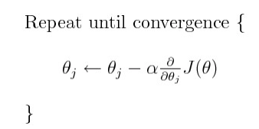
What is Gradient Descent
Gradient Descent Algorithm iteratively calculates the next point using gradient at the current position, scales it (by a learning rate) , and subtracts the obtained value from the current position (makes a step). It subtracts the value because we want to minimize the function (to maximize it would be adding). This process can be written as:
In summary, Gradient Descent (GD) method’s steps are:
Choose a starting point (initialization)
Calculate the gradient at this point
Make a scaled step in the opposite direction to the gradient (objective: minimize)
Repeat points 2 and 3 until one of the criteria is met:
maximum number of iterations reached
step size is smaller than the tolerance (due to scaling or a small gradient).

Slide 26
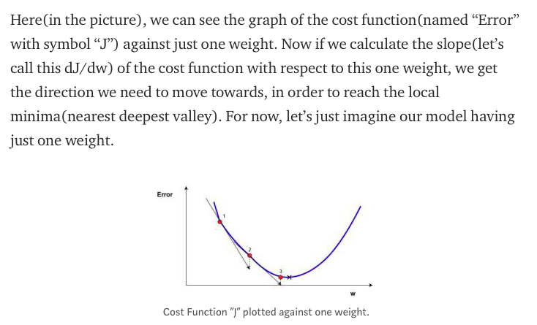
We need a cost function that is Convex function
A gradient simply measures the change in all weights with regard to the change in error. You can also think of a gradient as the slope of a function. The higher the gradient, the steeper the slope and the faster a model can learn. But if the slope is zero, the model stops learning. In mathematical terms, a gradient is a partial derivative with respect to its inputs.
Once the gradient is zero, you have reached a minimum!

Slide 27
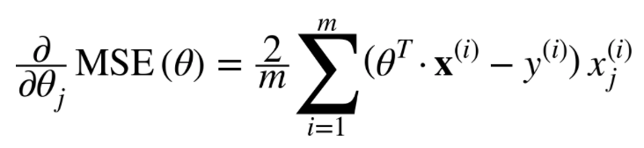
Implementing GD
To implement Gradient Descent, you need to compute the gradient of the cost function with regards to each model parameter θj.
In other words, you need to calculate how much the cost function will change if you change θj just a little bit.
This is called a partial derivative.
Compute the partial derivative of the cost function with regards to parameter θj
Gradient Descent step:

Slide 28
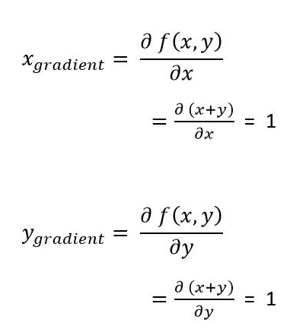
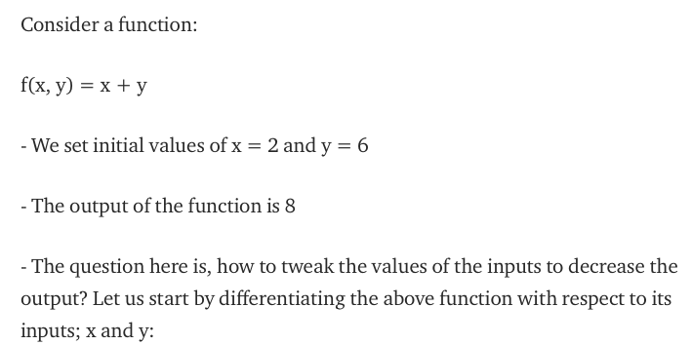
Stop! Do you know how to do that?
We want to make f(x, y)=0

Slide 29
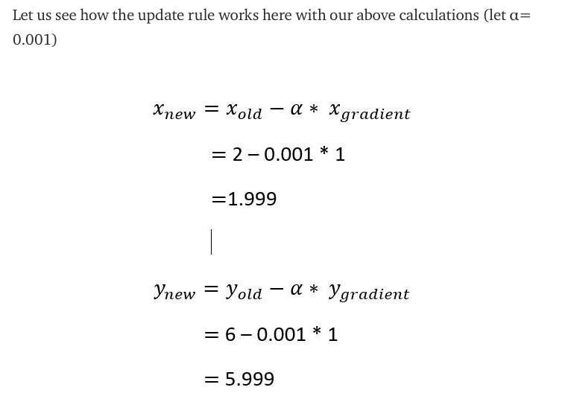
Continue…
So, if we repeat the above process 4000 times, we will get the values of x = -2 and y = 2.0, leading us to give the output of our function f(x, y) = 0. So, we have the expected values of x and y, which causes our function to give the minimum value of 0.
would give an output of 7.99 which is less than 8 ☺

Slide 30
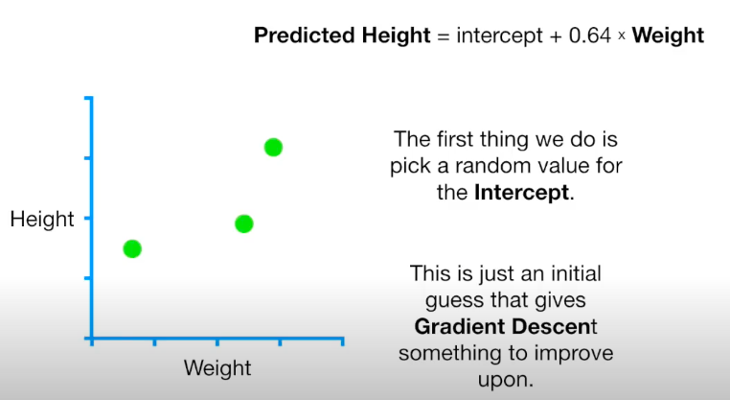
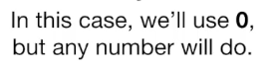
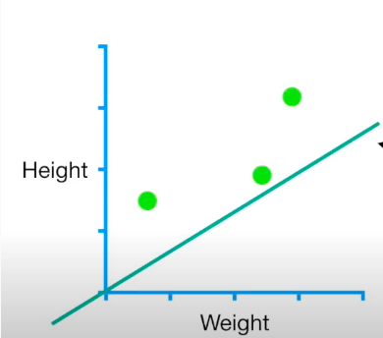
Example
Height= W0 + W1*Weight
Height= intercept + slope *Weight
We will use 0.64 for slope for now to find the intercept.
Weight 0.5 Height 1.4
Weight 2.3 Height 1.9
Weight 2.9 Height 3.2

Slide 31
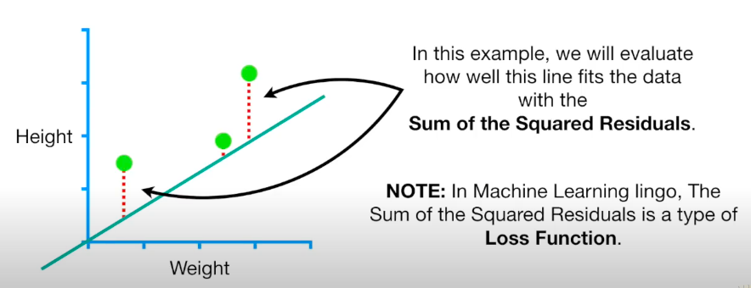
Continue…

Slide 32
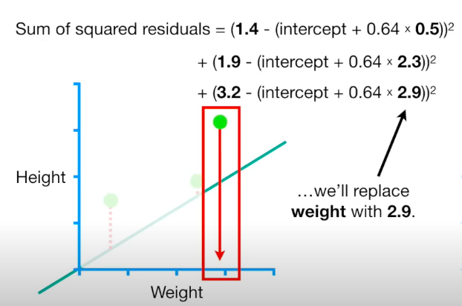
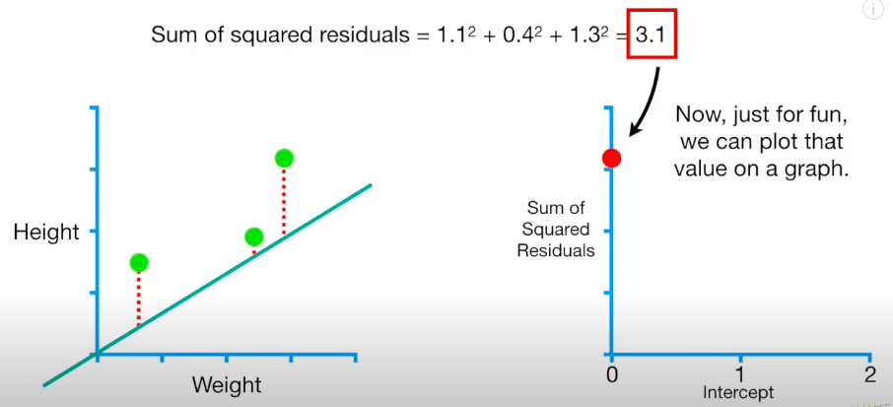
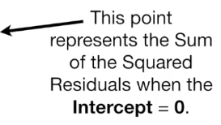
This is our Data Weight 0.5 Height 1.4
Weight 2.3 Height 1.9
Weight 2.9 Height 3.2

Slide 33
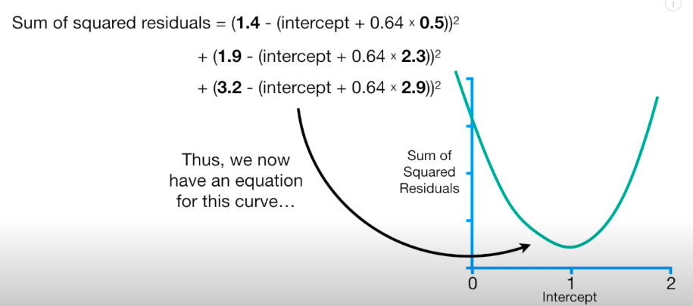
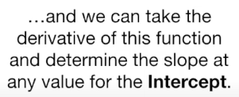
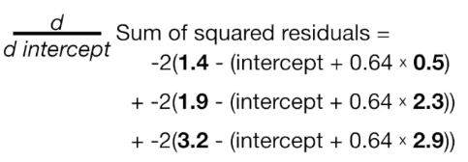
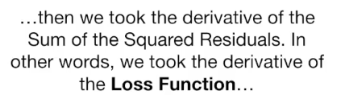
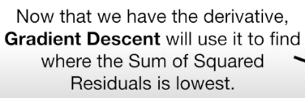
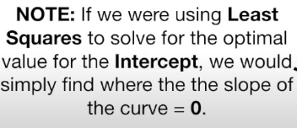

Slide 34
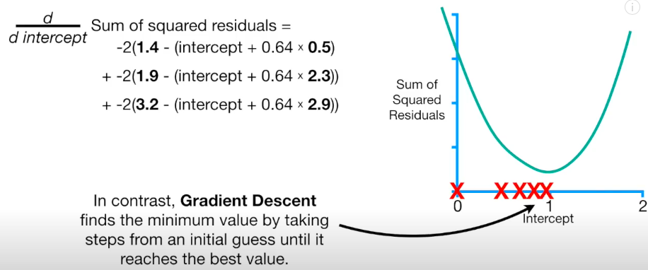





Slide 35


Slide 36





Slide 37



Slide 38





Watch this to see the rest of the lecture https://www.youtube.com/watch?v=sDv4f4s2SB8

Slide 39
Learning rate
Now that we have found the direction, we need to determine how much to nudge the weight. Here, we use the Learning Rate.
The Learning Rate is called a hyper-parameter.
A hyper-parameter is a value required by your model, which we really have very little idea about.
These values can be learned mostly by trial and error. There is no one-fits-all for hyper-parameters.
This Learning Rate can be thought of as a “step in the right direction,” where the direction comes from dJ/dw.
If the learning rate is too small, then the algorithm will have to go through many iterations to converge, which will take a long time.

Slide 40



Example
Let’s take a simple quadratic function defined as:
Because it is an univariate function, a gradient function is:
For this function, by taking a learning rate of 0.1 and starting point at x=9 we can easily calculate each step by hand. Let’s do it for the first 3 steps:

Slide 41

Animation
The animation below shows steps taken by the GD algorithm for learning rates of 0.1 and 0.8. As you see, for the smaller learning rate, as the algorithm approaches the minimum the steps are getting gradually smaller. For a bigger learning rate, it is jumping from one side to another before converging.
Notes:
https://towardsdatascience.com/gradient-descent-algorithm-a-deep-dive-cf04e8115f21

Slide 42

Another example
Number of iterations and the final converged result (within tolerance) for various learning rates are shown below: number of iterations and the final converged result (within tolerance) for various learning rates are shown below:

Slide 43


Function with Saddle Point ☹
Now let’s see how the algorithm will cope with a semi-convex function we investigated mathematically before.
Below an animation for a learning rate of 0.4 and a starting point x=-0.5.
https://towardsdatascience.com/gradient-descent-algorithm-a-deep-dive-cf04e8115f21

Slide 44



Problems with Gradient Descent

Slide 45

Important!
When using Gradient Descent, you should ensure that all features have a similar scale (e.g., using Scikit-Learn’s StandardScaler class), or else it will take much longer to converge.
Fortunately, the MSE cost function for a Linear Regression model happens to be a convex function, which means that if you pick any two points on the curve, the line segment joining them never crosses the curve. This implies that there are no local minima, just one global minimum.
It is also a continuous function with a slope that never changes abruptly

Slide 46
Types of Gradient Descent
There are three popular types of Gradient Descent that mainly differ in the amount of data they use:
Batch Gradient Descent: calculates the error for each example within the training dataset, but only after all training examples have been evaluated, the model gets updated. This whole process is like a cycle and is called a training epoch. It requires that the entire training dataset is in memory and available to the algorithm.
Stochastic Gradient Descent (SGD): just picks a random instance in the training set at every step and computes the gradients based only on that single instance. So once the algorithm stops, the final parameter values are good, but not optimal.
Mini Batch Gradient Descent: it’s a combination of the concepts of SGD and Batch Gradient Descent. It simply splits the training dataset into small batches and performs an update for each of these batches. Therefore, it creates a balance between the robustness of stochastic gradient descent and the efficiency of batch gradient descent.

Slide 47
Batch Gradient Descent
In Batch Gradient Descent, all the training data is taken into consideration to take a single step. We take the average of the gradients of all the training examples and then use that mean gradient to update our parameters. So that’s just one step of gradient descent in one epoch.
Epoch: each iteration over training set

Slide 48


Example!

Slide 49

Step 1: Initialize the weights(a & b) with random values and calculate Error
Step 2: Calculate the gradient i.e. change in error when the weights (a & b) are changed by a very small value from their original randomly initialized value. This helps us move the values of a & b in the direction in which error is minimized.
Step 3: Adjust the weights with the gradients to reach the optimal values where error is minimized
Step 4: Use the new weights for prediction and to calculate the new error
Step 5: Repeat steps 2 and 3 till further adjustments to weights doesn’t significantly reduce the Error
our objective is to find optimal a, b that minimizes the error between actual and predicted values
Notes:
https://deepnote.com/app/brindhag/Gradient-Descent-fb0dc7ce-1e6e-4f6d-a3e5-cec0f22fe732

Slide 50


continue
Standardize the data

Slide 51

rememebr
( m – k)² = m² -2mk + k²

Slide 52

Step 3:

Slide 53
Stochastic Gradient Descent
In Batch Gradient Descent we consider all the examples for every step. But what if our dataset is very huge? Suppose our dataset has 5 million examples. This is not an efficient way. To tackle this problem, we have Stochastic Gradient Descent. In Stochastic Gradient Descent (SGD), we consider just one example at a time to take a single step. We do the following steps in SGD:
Initialize the parameters (weights) of your model.
In each iteration of the training process, SGD randomly selects a single data point.
Calculate the gradient of the loss function, but only for the randomly selected data point.
Use the gradient we calculated in Step 3 to update the weights
Repeat steps 2 to 4 for a set number of iterations or until the model performance stops improving.

Slide 54
Stochastic Gradient Descent
Each time the parameter is updated, it is known as an Iteration.
In the Batch Gradient Descent, we would have passed all the observations together and the parameters have been updated only once.
In the case of SGD, there will be ‘m’ iterations per epoch, where ‘m’ is the number of observations in a dataset.

Slide 55

MiniBatch Gradient Descent
Mini Batch Gradient Descent: it’s a combination of the concepts of SGD and Batch Gradient Descent. It simply splits the training dataset into small batches and performs an update for each of these batches. Therefore, it creates a balance between the robustness of stochastic gradient descent and the efficiency of batch gradient descent.

Slide 56



Polynomial Regression
Linear regression requires the relation between the dependent variable and the independent variable to be linear. What if the distribution of the data was more complex, as shown in the below figure? Can linear models be used to fit non-linear data? How can we generate a curve that best captures the data as shown below?

Slide 57


To overcome under-fitting, we need to increase the complexity of the model
from sklearn.linear_model import LinearRegression
model = LinearRegression()
model.fit(x, y)
y_pred = model.predict(x)

Slide 58

Learning Curves
If you perform high-degree Polynomial Regression, you will likely fit the training data much better than with plain Linear Regression. But?!?!?

Slide 59


A simple way to do this is to add powers of each feature as new features and then train a linear model on this extended set of features. This technique is called Polynomial Regression.
This is still considered a linear model as the coefficients/weights associated with the features are linear.
x² is only a feature. However, the curve that we are fitting is quadratic in nature.
To convert the original features into their higher-order terms, we will use the PolynomialFeatures class provided by scikit-learn. Next, we train the model using Linear Regression.
The linear model,
can be transformed to
from sklearn.preprocessing import PolynomialFeatures

Slide 60
Regularized Linear Models
A good way to reduce overfitting is to regularize the model
A simple way to regularize a polynomial model is to reduce the number of polynomial degrees.
We will now look at Ridge Regression, Lasso Regression, and Elastic Net
“Ridge” is a fancy name for L2-regularization, “LASSO” means L1-regularization, “ElasticNet” is a ratio of L1 and L2 regularization.
We will also look at Early Stopping and Logistic Regression.

Slide 61

Ridge
Ridge regression shrinks the regression coefficients, so that variables, with minor contribution to the outcome, have their coefficients close to zero.
The shrinkage of the coefficients is achieved by penalizing the regression model with a penalty term called L2-norm, which is the sum of the squared coefficients.
The amount of the penalty can be fine-tuned using a constant called lambda (λ or ⍺). Selecting a good value for ⍺ is critical.
When ⍺ =0, the penalty term has no effect, and ridge regression will produce the classical least square coefficients. However, as ⍺ increases to infinite, the impact of the shrinkage penalty grows, and the ridge regression coefficients will get close zero.
Ridge regression shrinks the coefficients towards zero, but it will not set any of them exactly to zero. The lasso regression is an alternative that overcomes this drawback.

Slide 62



Lasso
Lasso stands for Least Absolute Shrinkage and Selection Operator. It shrinks the regression coefficients toward zero by penalizing the regression model with a penalty term called L1-norm, which is the sum of the absolute coefficients.
In the case of lasso regression, the penalty has the effect of forcing some of the coefficient estimates, with a minor contribution to the model, to be exactly equal to zero. This means that, lasso can be also seen as an alternative to the subset selection methods for performing variable selection in order to reduce the complexity of the model.
As in ridge regression, selecting a good value of ⍺ for the lasso is critical.
Ridge
LASSO
OR

Slide 63

Elastic Net
Elastic Net produces a regression model that is penalized with both the L1-norm and L2-norm. The consequence of this is to effectively shrink coefficients (like in ridge regression) and to set some coefficients to zero (as in LASSO).

